Slide 1
Presentation of My First website

Slide 2
HELLO!
I am Xinzhe Yu

Slide 3
URL of website: https://upbeat-hugle-a51ec0.netlify.app/
Github repo: https://github.com/Todd0554/potfolio_src

Slide 4
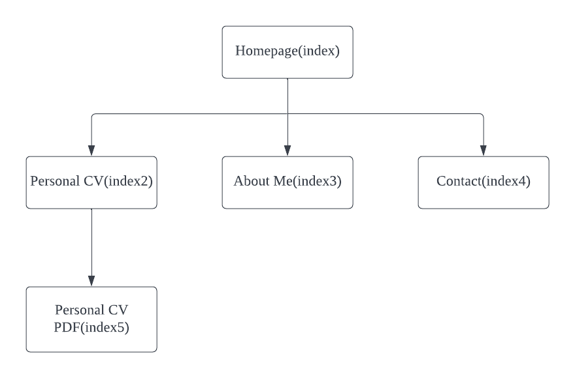
Website Structure

Slide 5
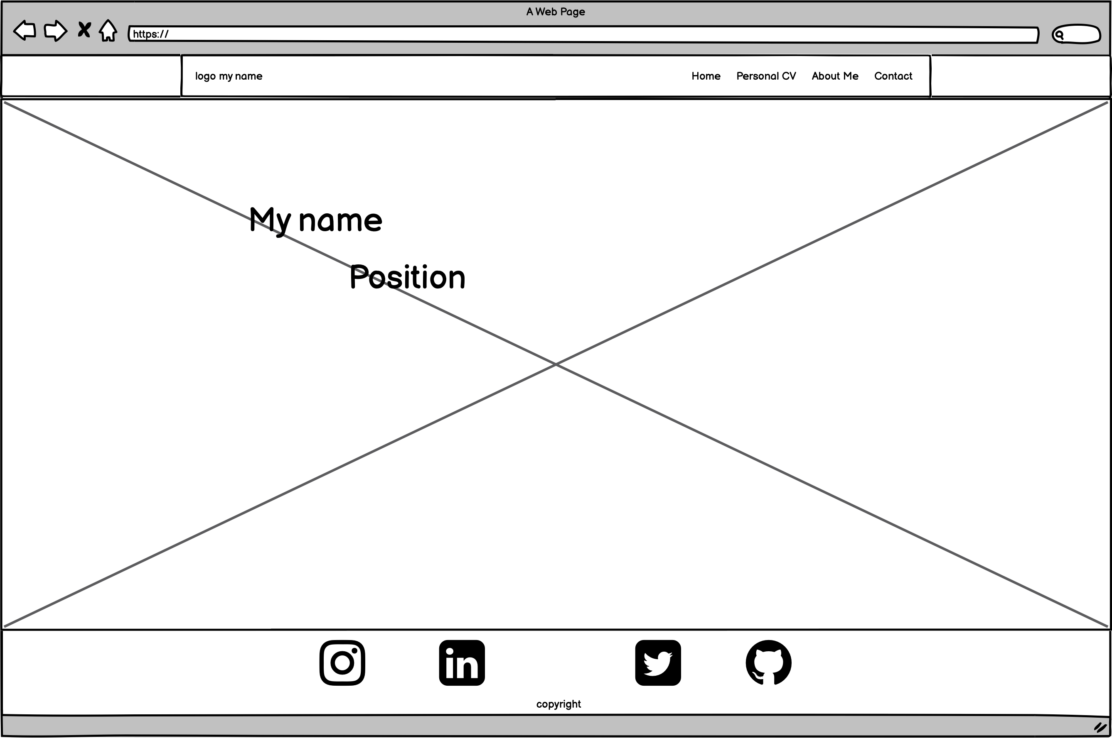
Homepage
Navbar
Background
Animated text
Rotated icons of social media
Footer

Slide 6
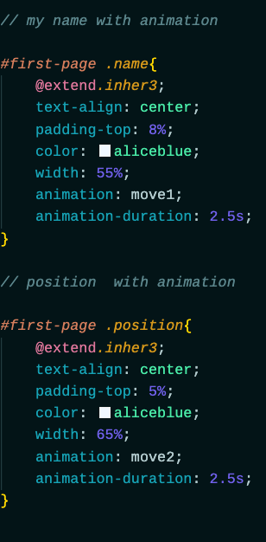
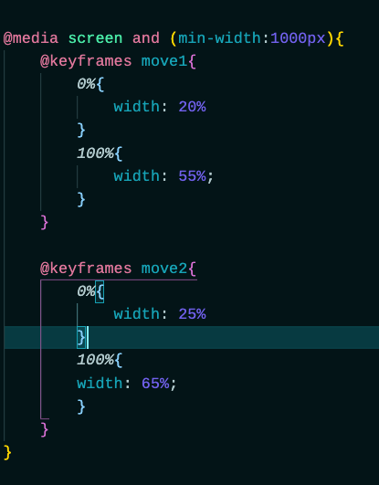
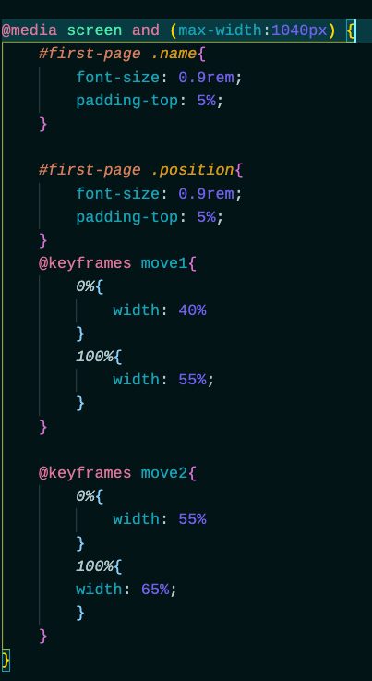
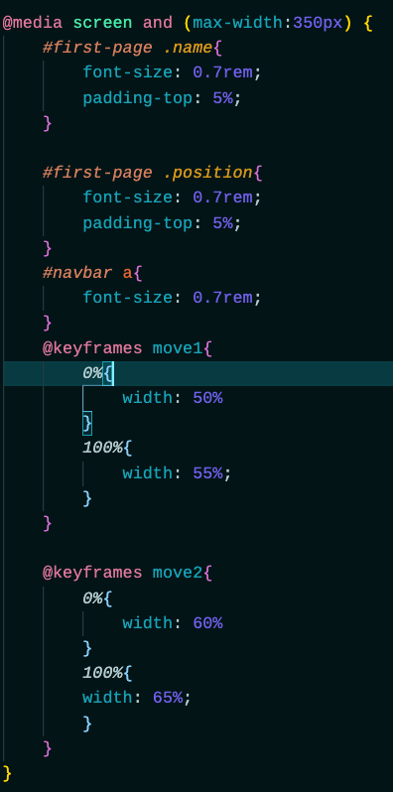
Homepage
Responsive settings of animated text

Slide 7
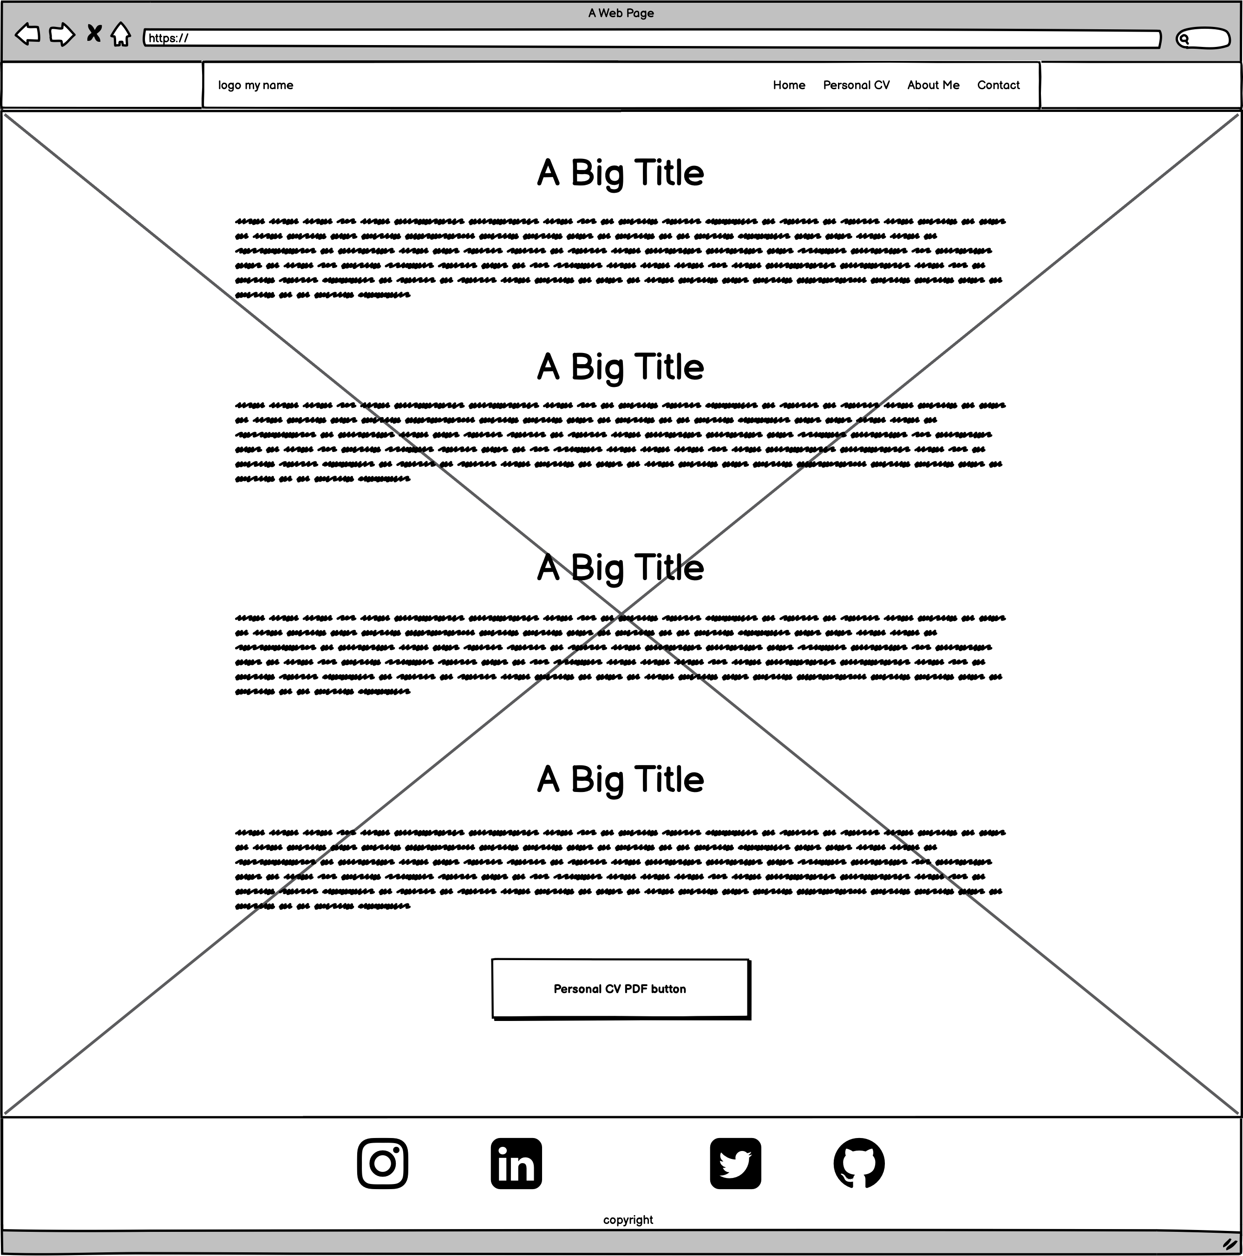
Personal CV page
Text in <div>
Button linked with PDF

Slide 8
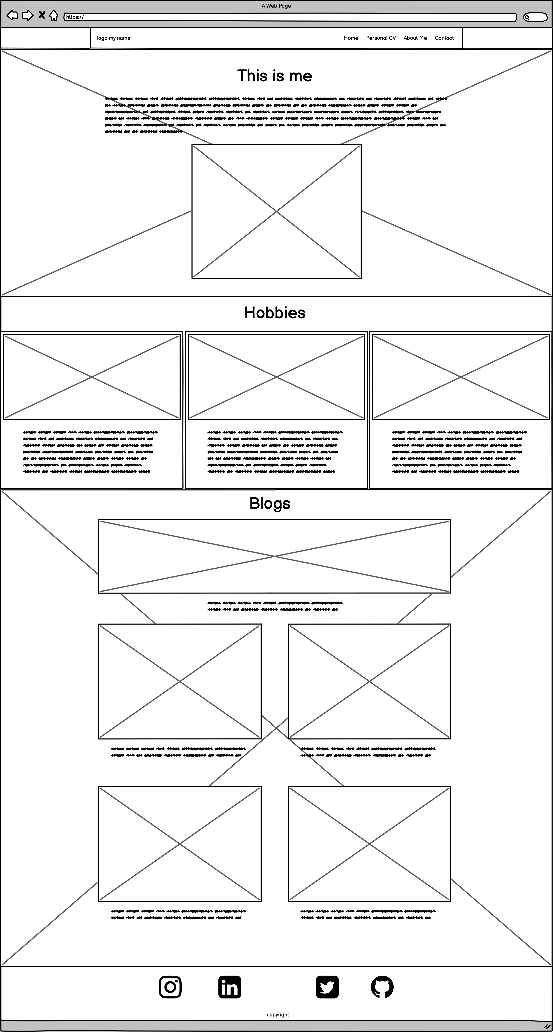
About Me page
Simple introduction with photo
Three cards section
Blogs

Slide 9
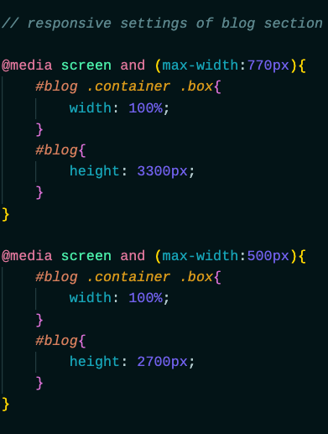
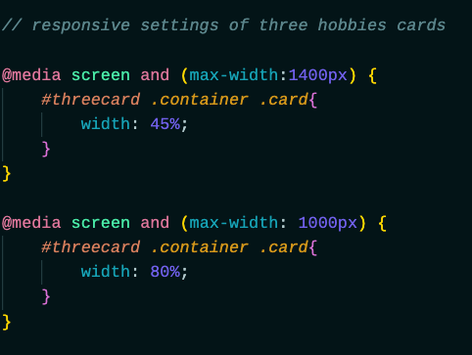
About Me page
Responsive code

Slide 10
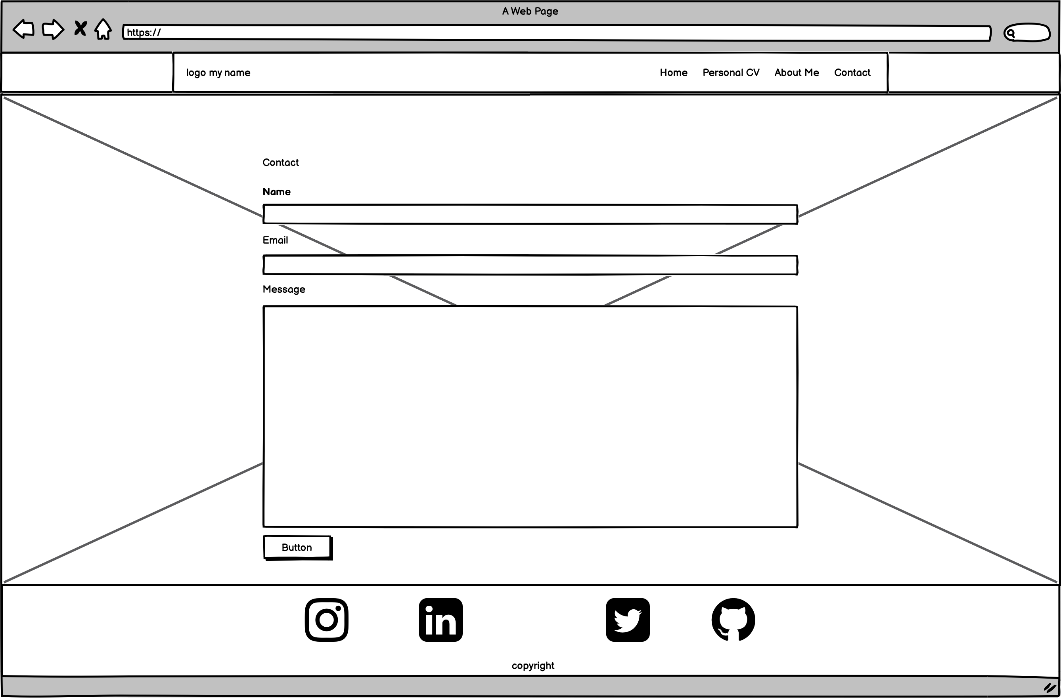
Contact page
Input box
Textarea
Send button

Slide 11
Challenges
Responsive settings
Looking for suitable image and making them into suitable size
Organizing SCSS e.g simplifying a part of code

Slide 12
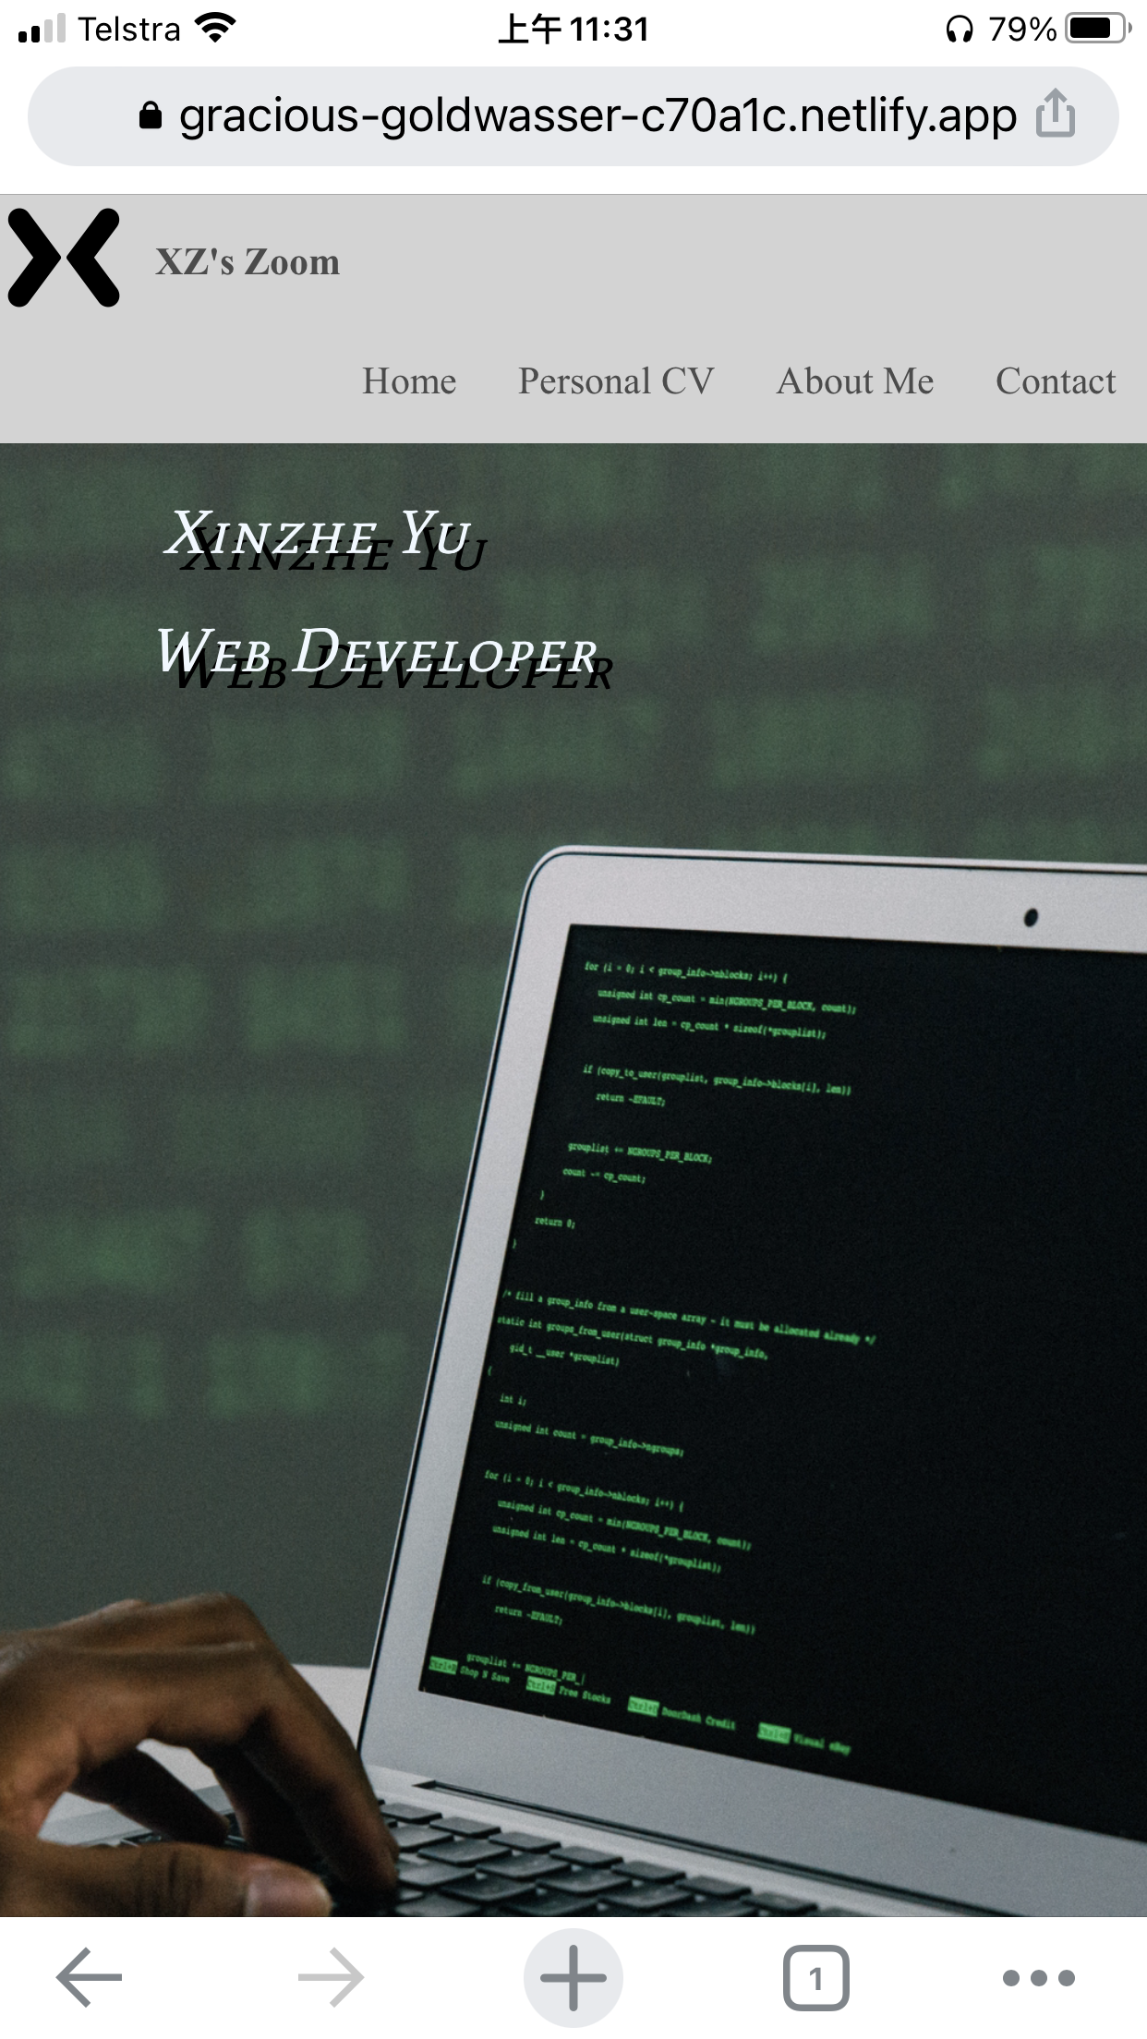

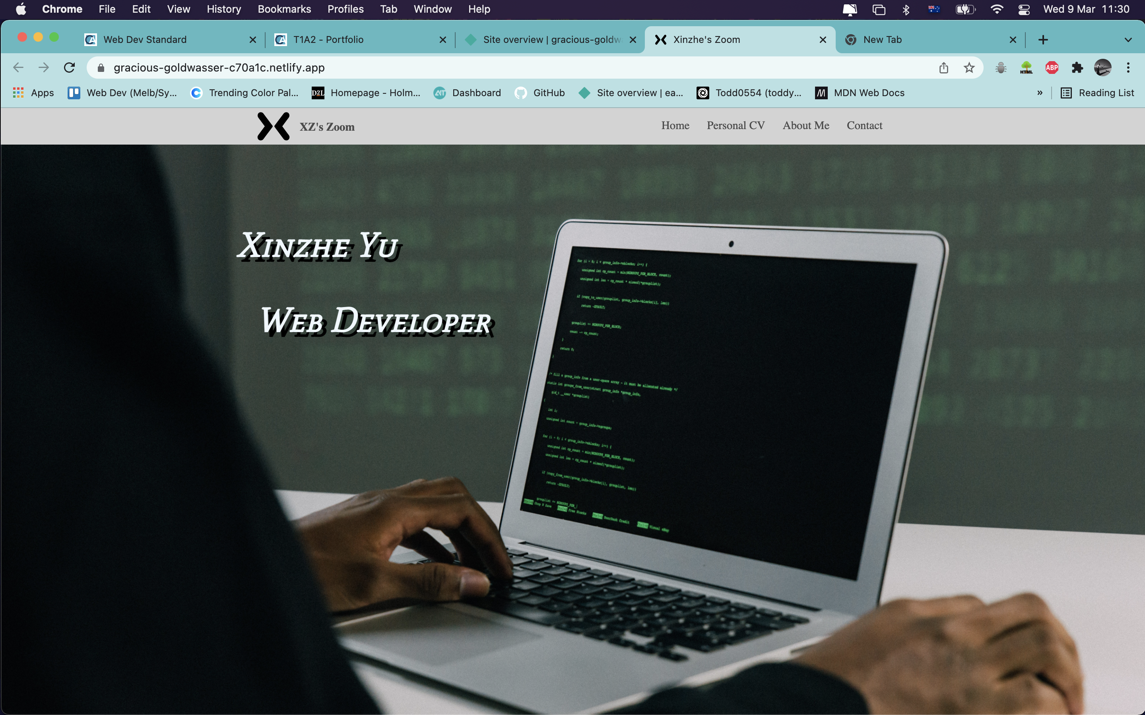

Features of this website

Slide 13
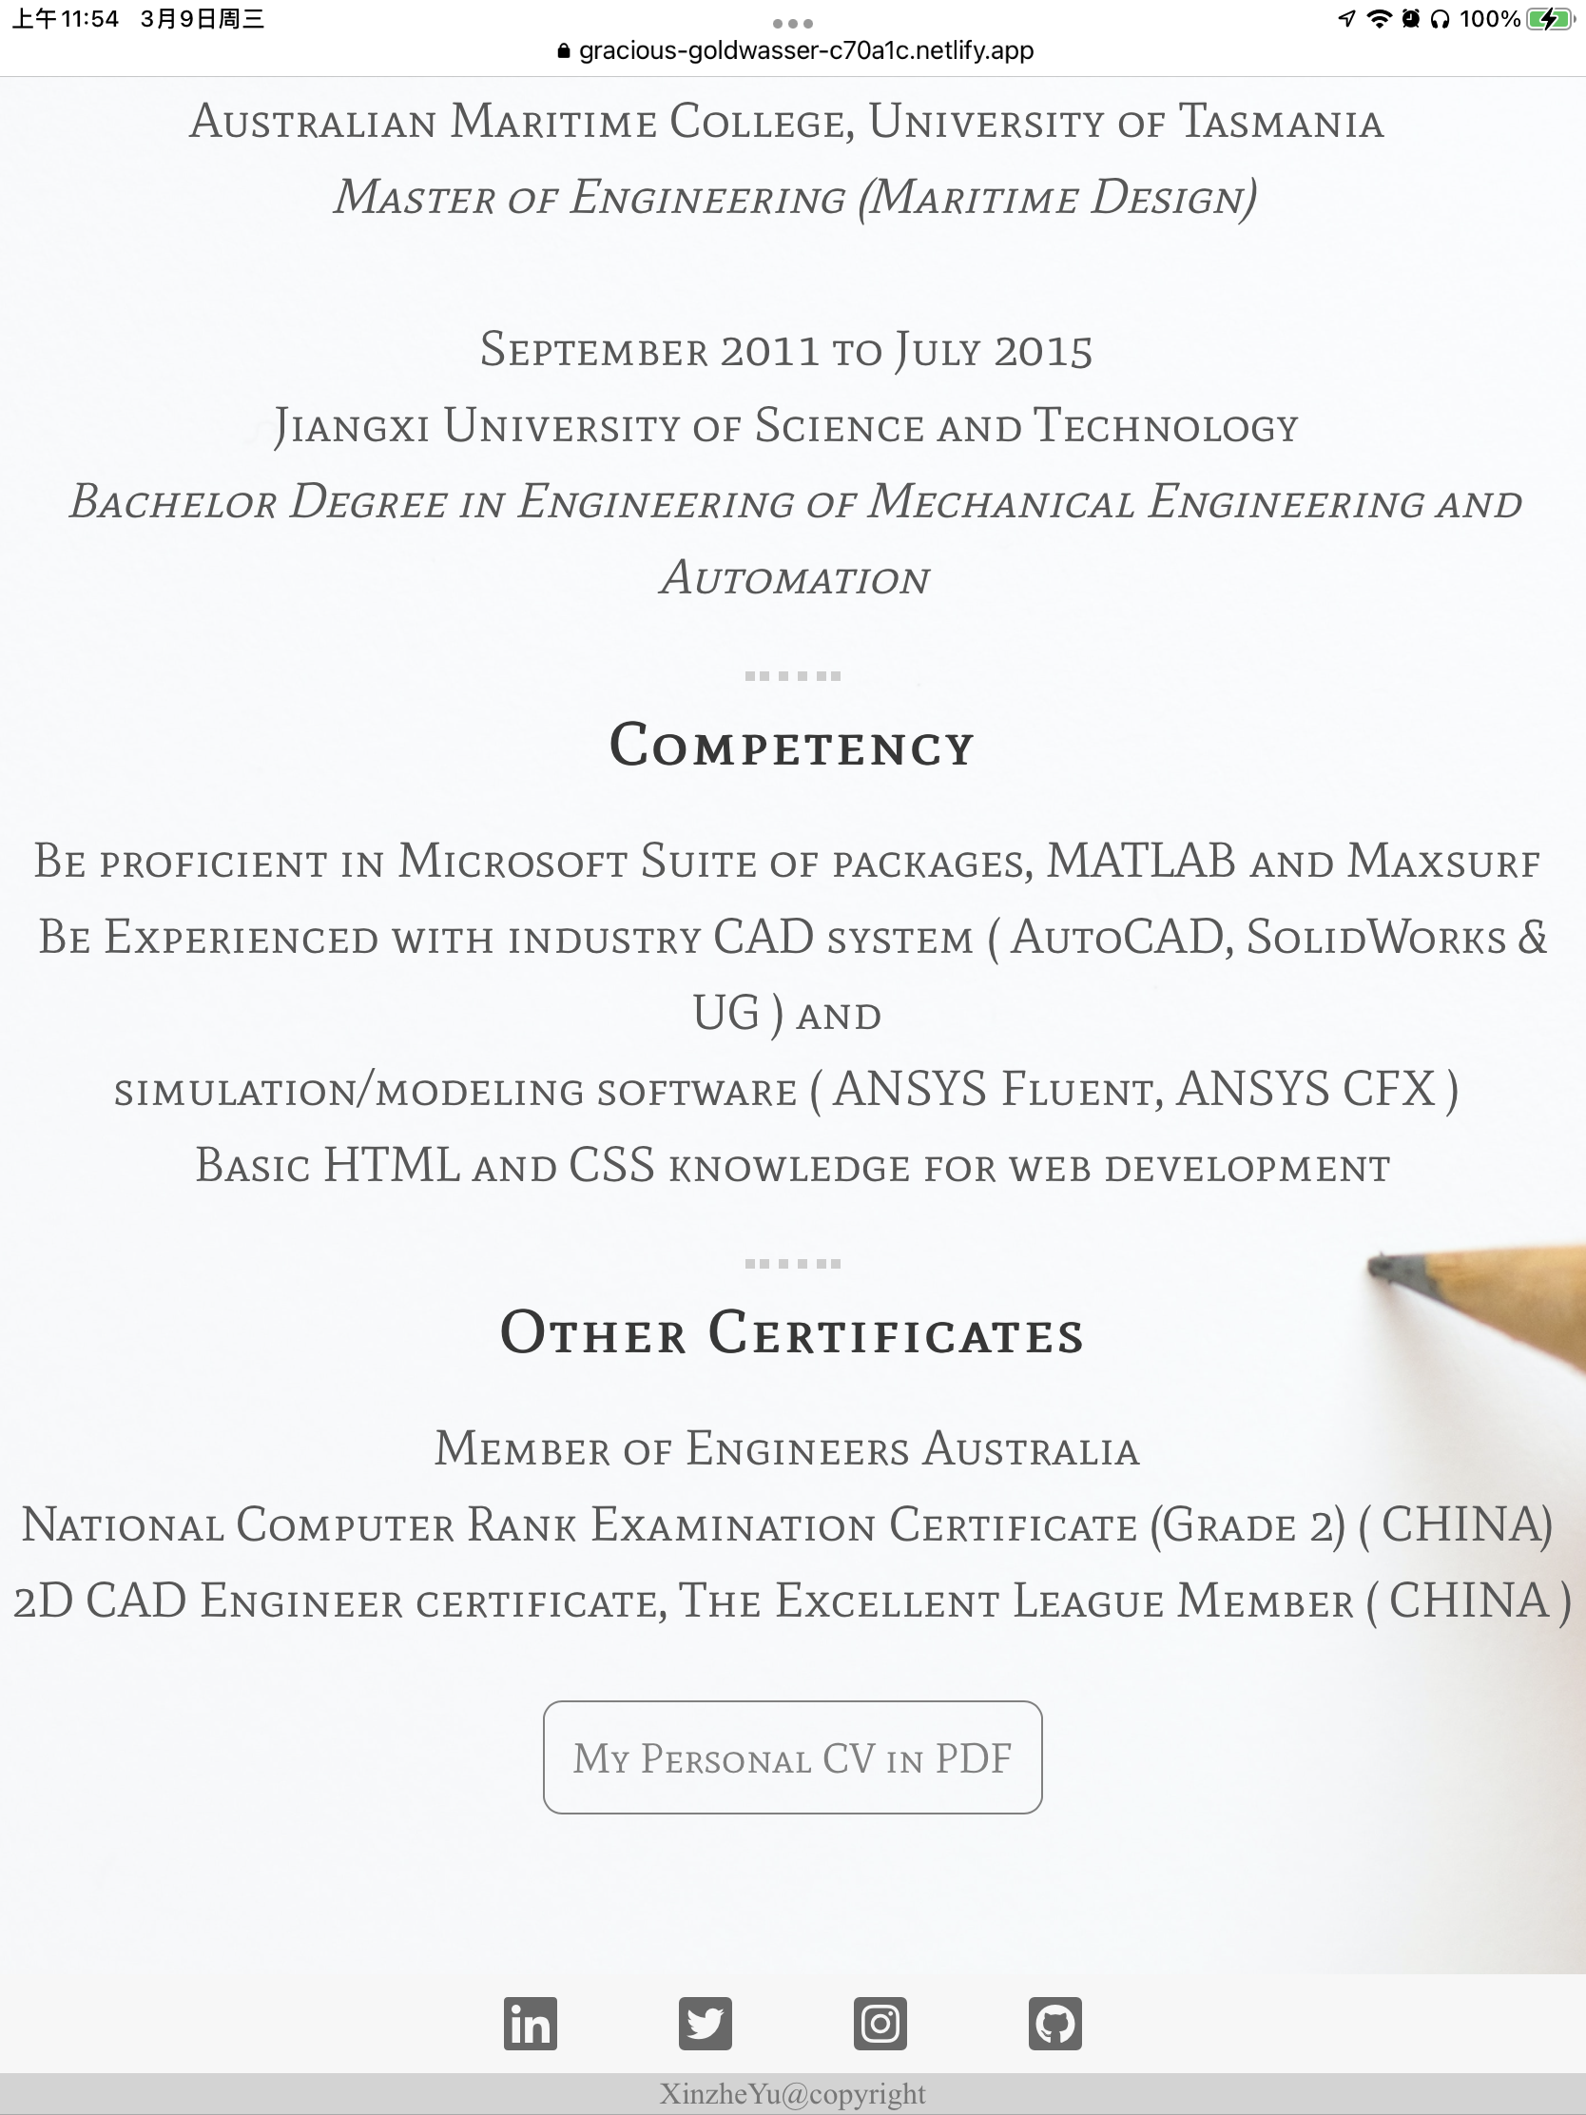
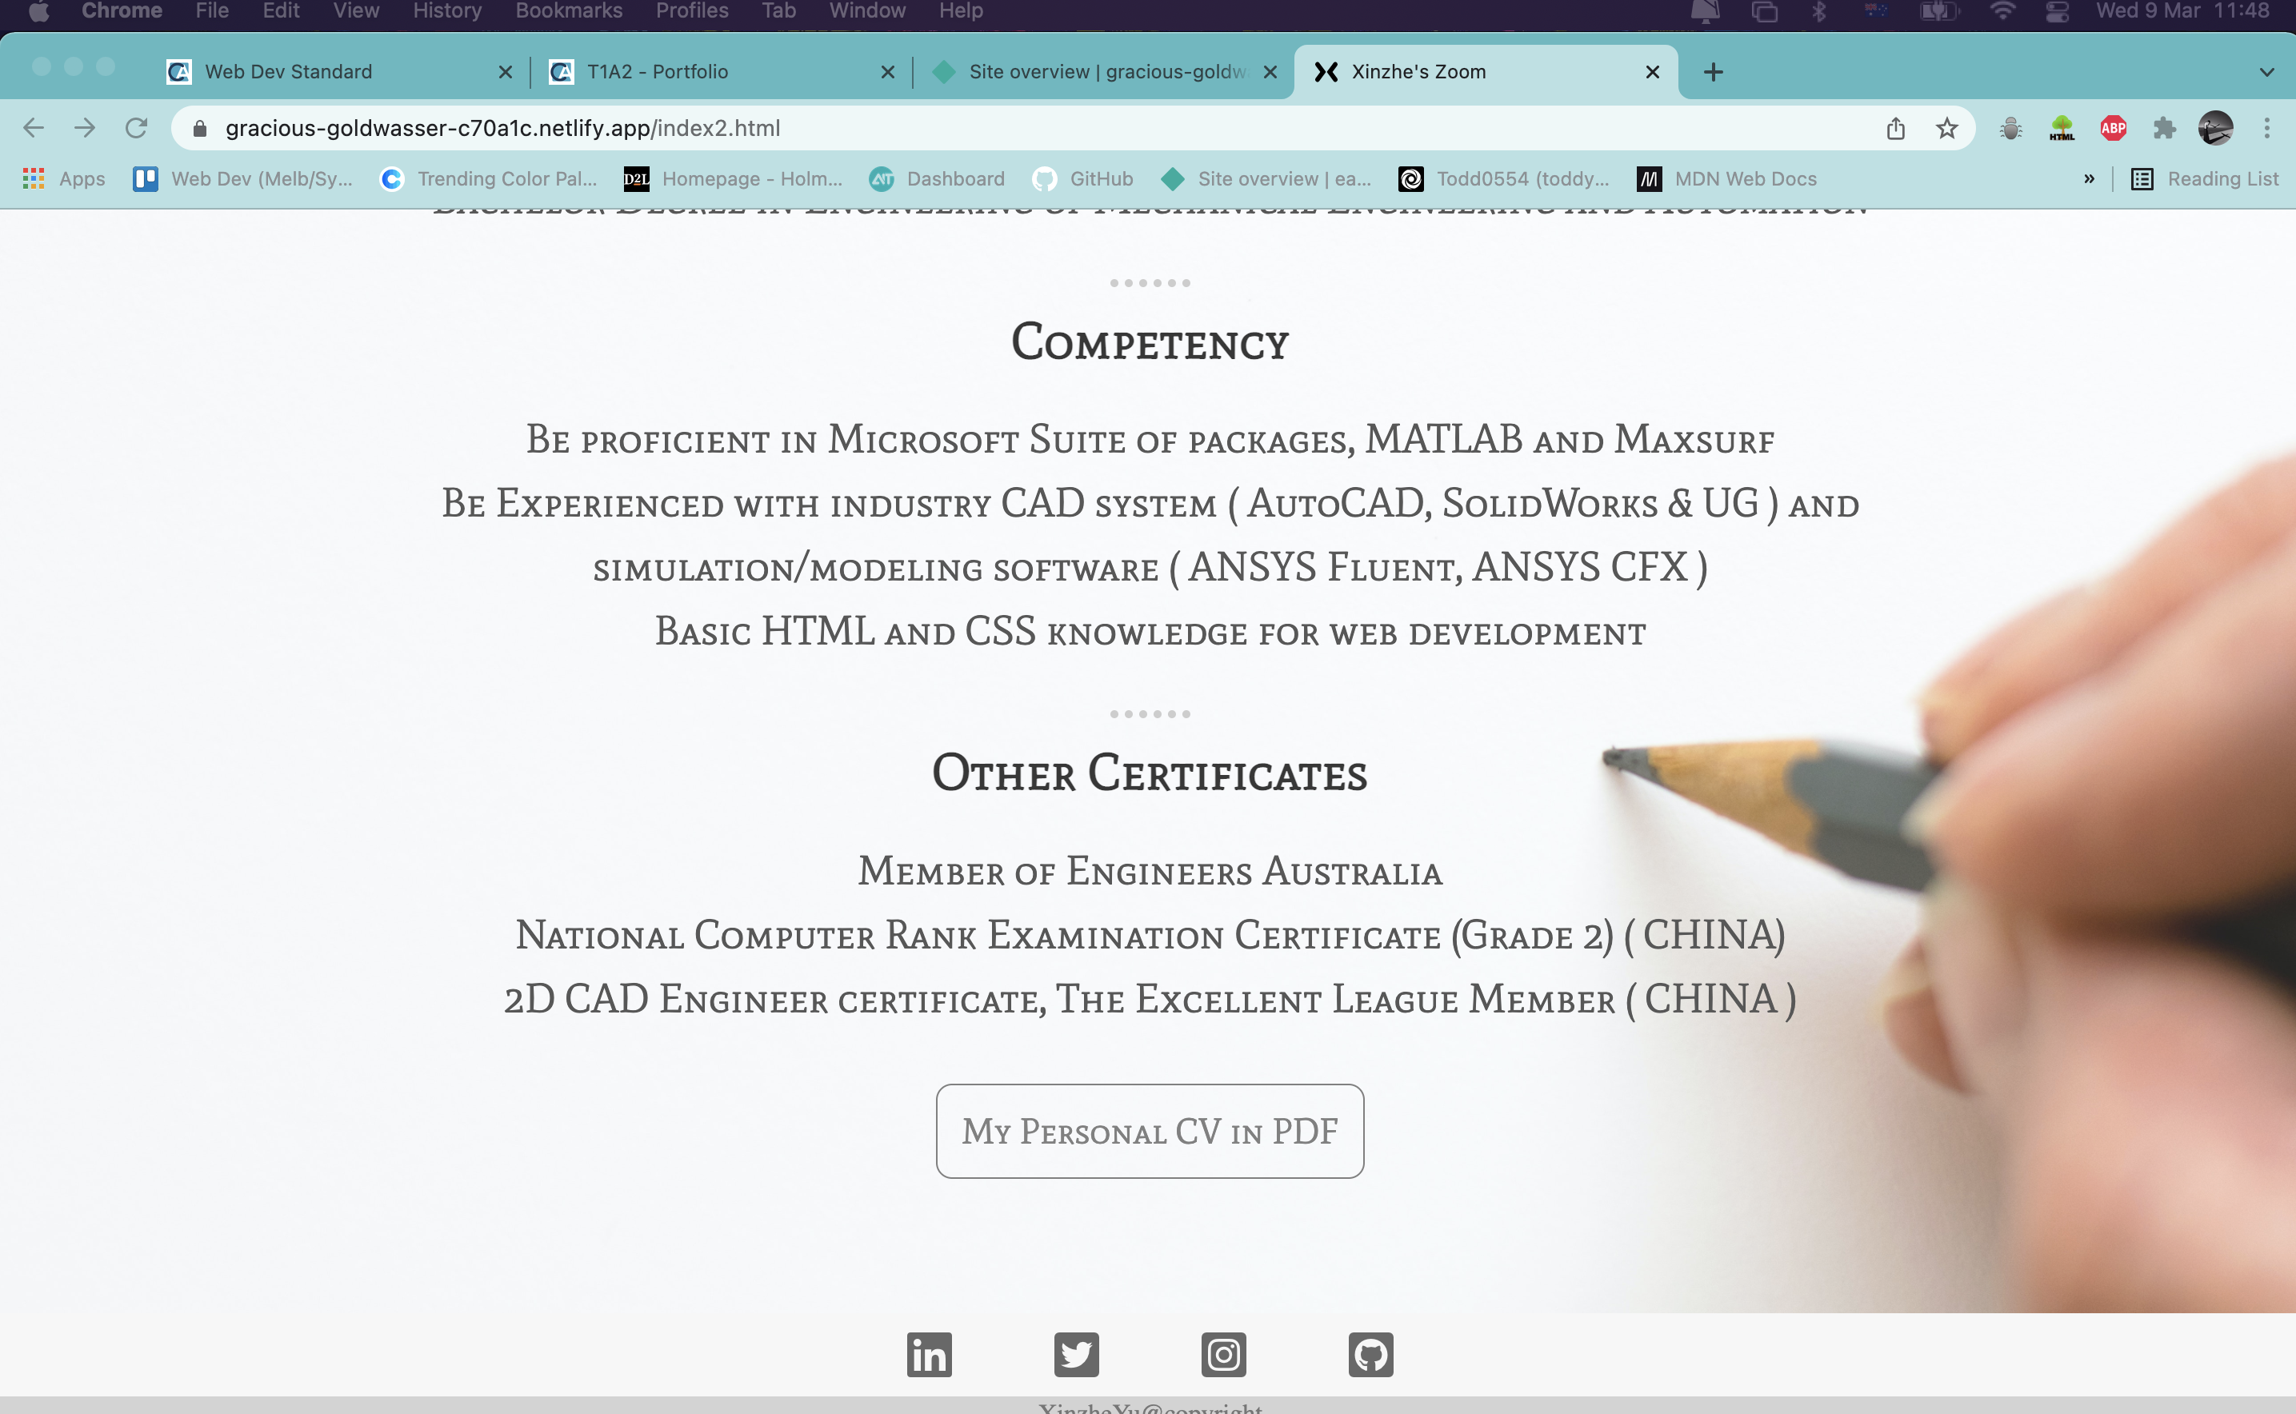
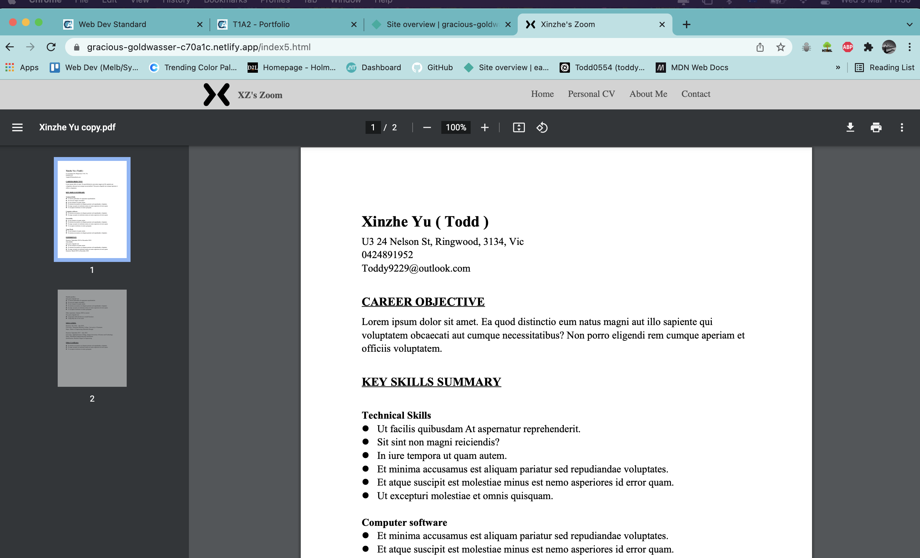
Features of this website

Slide 14
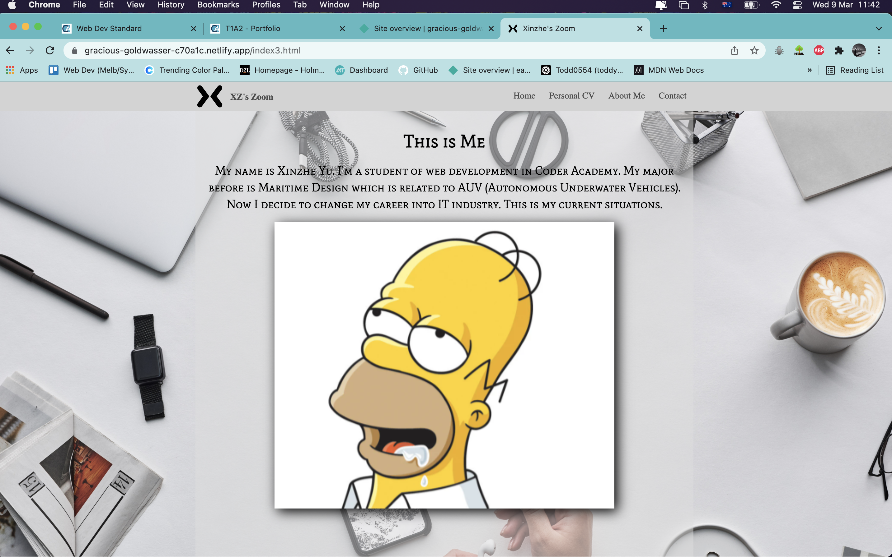
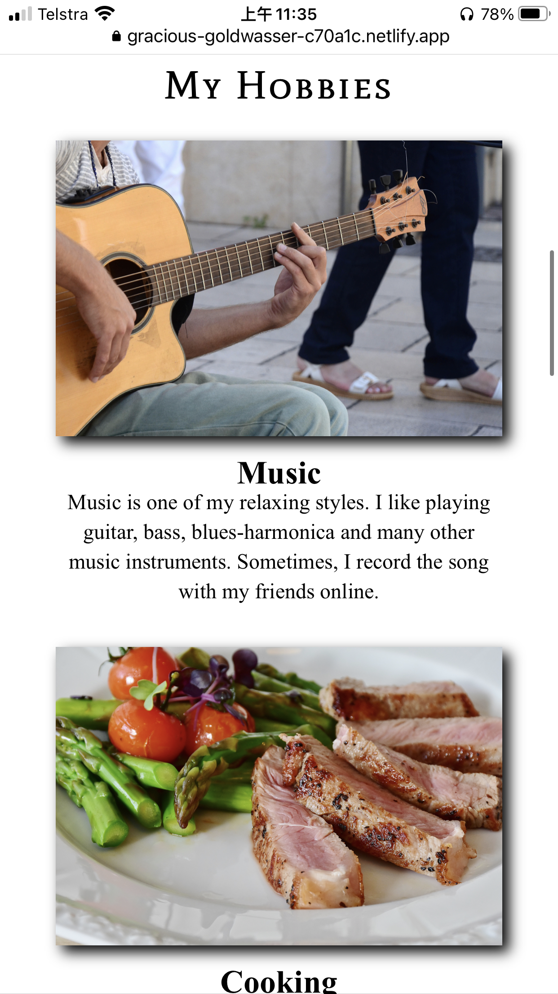
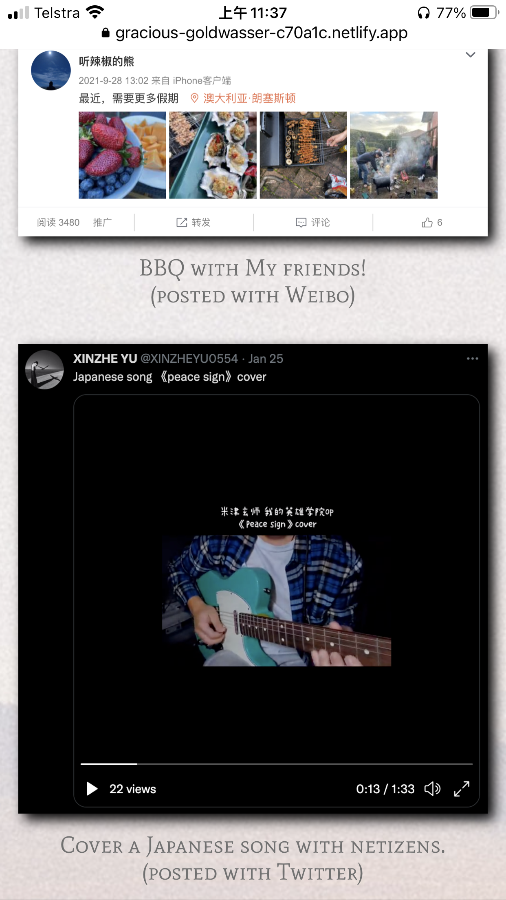

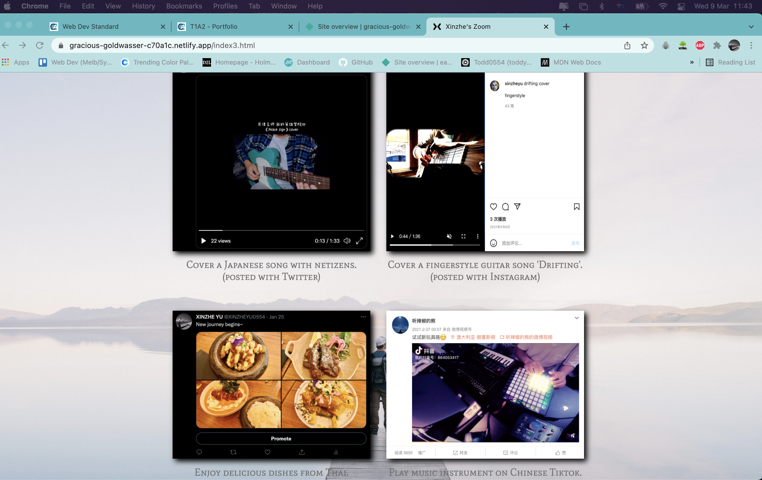
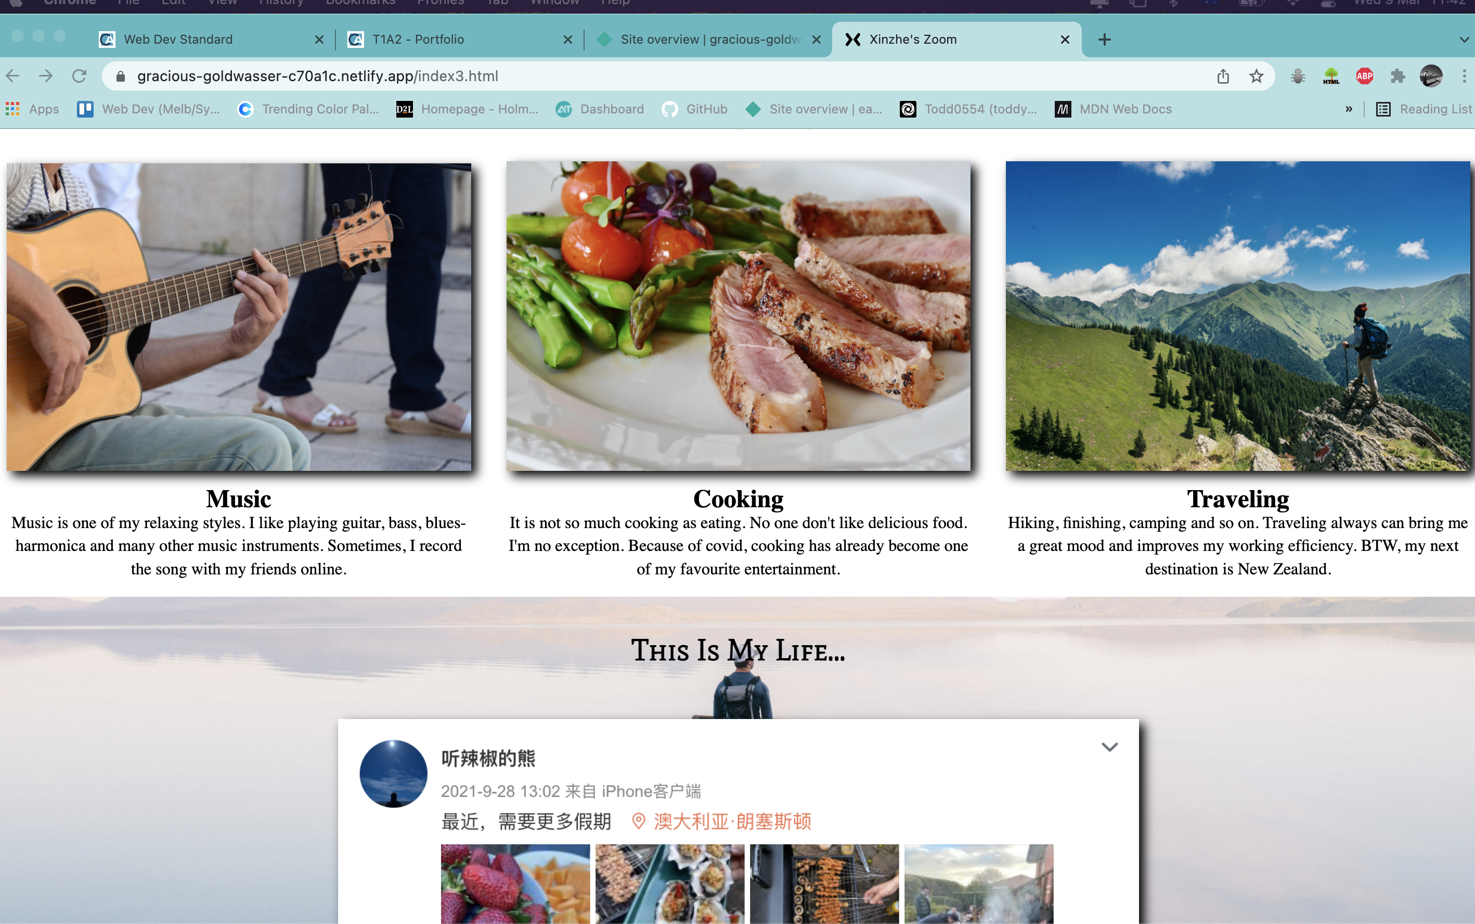
Features of this website

Slide 15
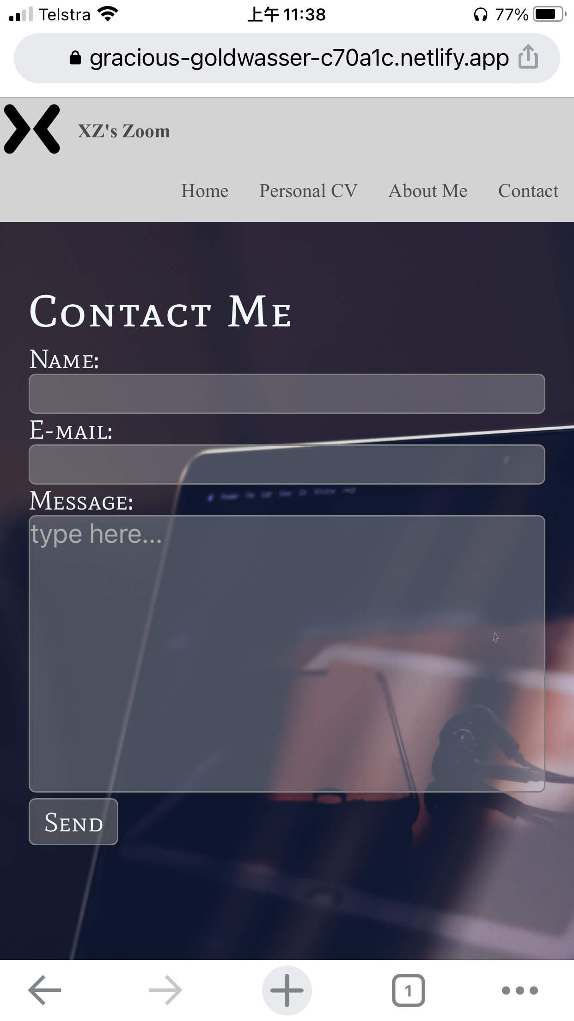
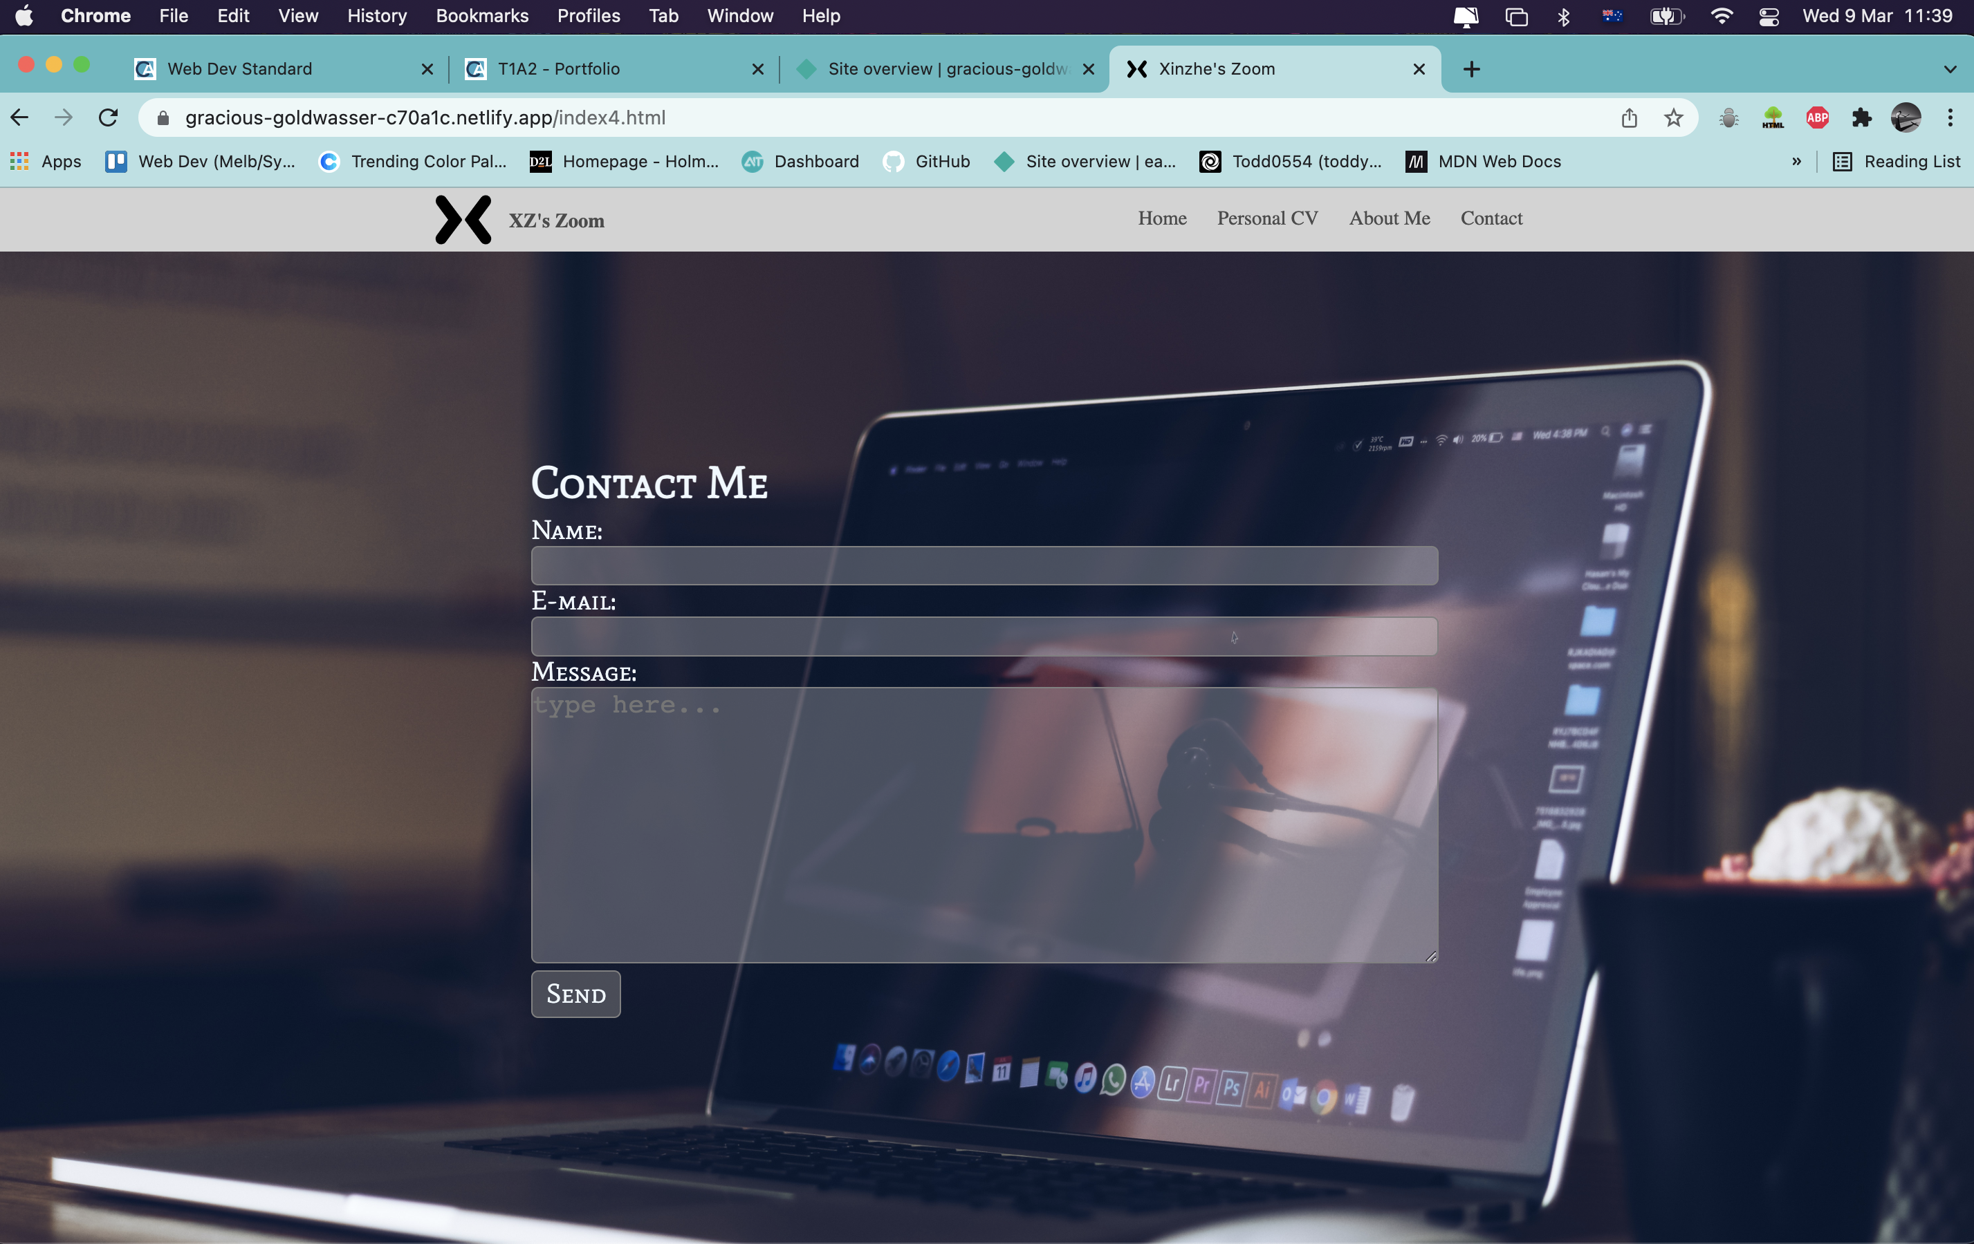
Features of this website

Slide 16

The End Thank You !

